Slide 1




GLOBAL SUICIDE RATE ANALYSIS
DONE BY
ROHIT JUPALLE AP21110011423
LAKSHMIPATHI AP21110011457
Y.TONY BABU AP21110011488

Slide 2

About project
The Global Suicide Rate Analysis project is designed to investigate the patterns and factors associated with suicide rates around the world, covering data from 1985 to 2016. This period includes diverse economic, political, and social transformations that have shaped national policies, public health strategies, and quality of life. By studying this data over three decades, the project aims to explore how various socioeconomic indicators—such as GDP per capita, Average suicide rate per 100k population, gender and suicide rates—interrelate and influence public health outcomes. This analysis will use Hive and Ambari for data processing, enabling efficient handling and querying of extensive datasets for reliable aggregation and insights.

Slide 3
Introduction to Hive
Hive is a data warehousing and SQL-like query language system built on top of Hadoop, designed to facilitate the management and analysis of large datasets stored in the Hadoop Distributed File System (HDFS). Originally developed by Facebook, Hive allows users to write queries in a language called HiveQL, which is similar to SQL, making it accessible to those familiar with traditional relational database systems.
One of the key features of Hive is its ability to perform batch processing of large datasets efficiently, making it ideal for tasks like data summarization, querying, and analysis. Hive’s integration with the Hadoop ecosystem allows it to leverage Hadoop's scalability and fault tolerance, enabling it to process the data seamlessly.

Slide 4
About Dataset
The Global Suicide Rate dataset, sourced from Kaggle, provides a detailed snapshot of suicide statistics across diverse countries and demographics, covering 27,820 entries with data from 1985 to 2016. This dataset includes 12 columns with key demographic attributes like age, sex, and generation, allowing insights into suicide rates across various population segments and time frames.
Each row specifies a unique group within a country for a particular year, enabling year-by-year trend analysis. Age groups are split into six ranges, from 5-14 to 75+ years, revealing how suicide rates might differ across life stages. Gender-specific data helps to examine variations in suicide rates between males and females, while generational categories, including Millennials, Generation Z, and Boomers, provide insights into how societal shifts and experiences impact mental health across generations.

Slide 5

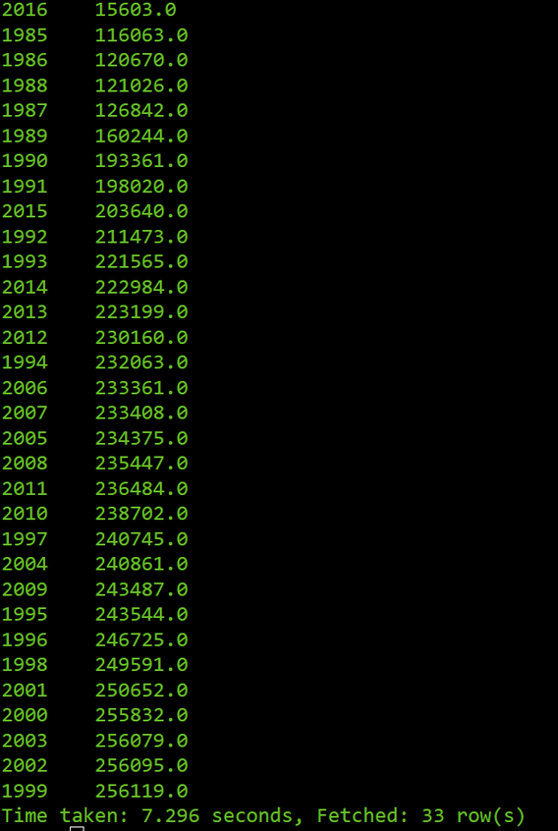
Analysis of data
Analyzing the data for Year versus suicide count reveals trends and patterns that can provide insights into the prevalence of suicides over time.

Slide 6


Gender Vs Suicides
Gender Vs Avg Suicide Rate per 100k

Slide 7
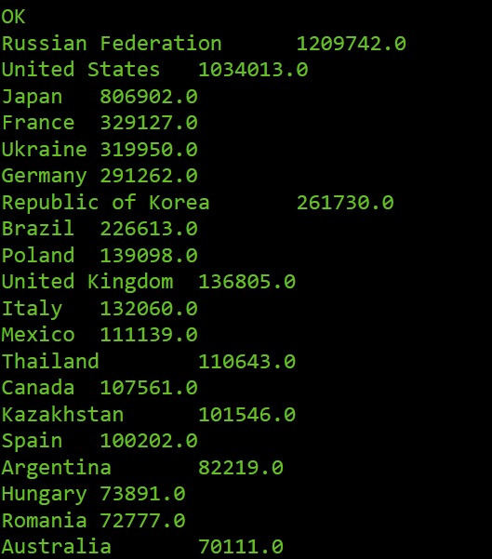
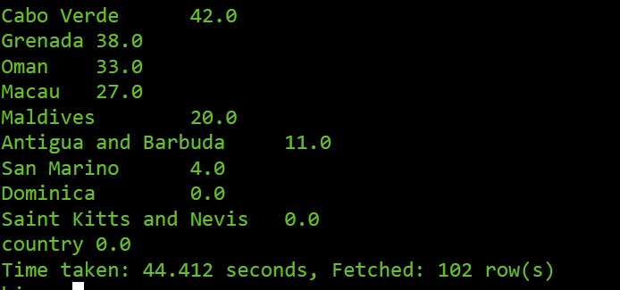
Country Vs Suicides

Slide 8

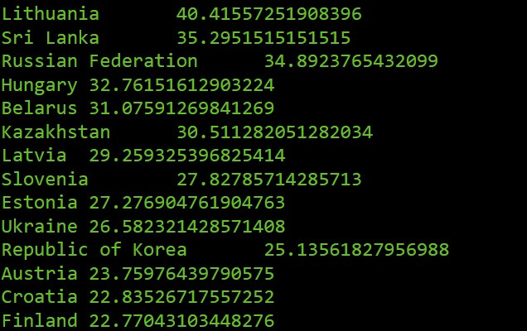
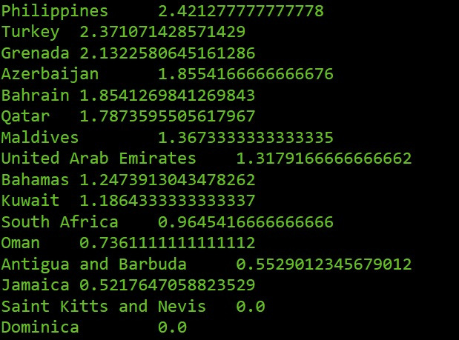
Country Vs Avg suicide Rate

Slide 9
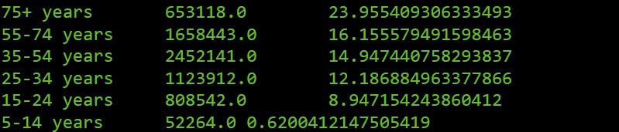
Age Vs Total Suicides

Slide 10
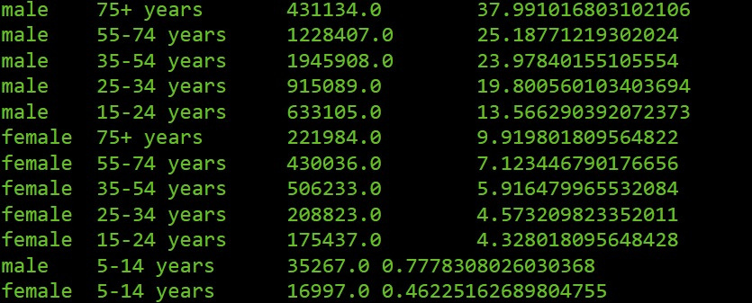
Gender , Age , Total and Avg Suicide per 100k

Slide 11
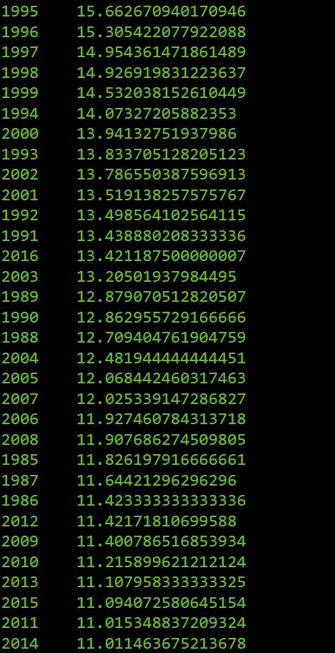
Year Vs Avg Suicide Rate

Slide 12
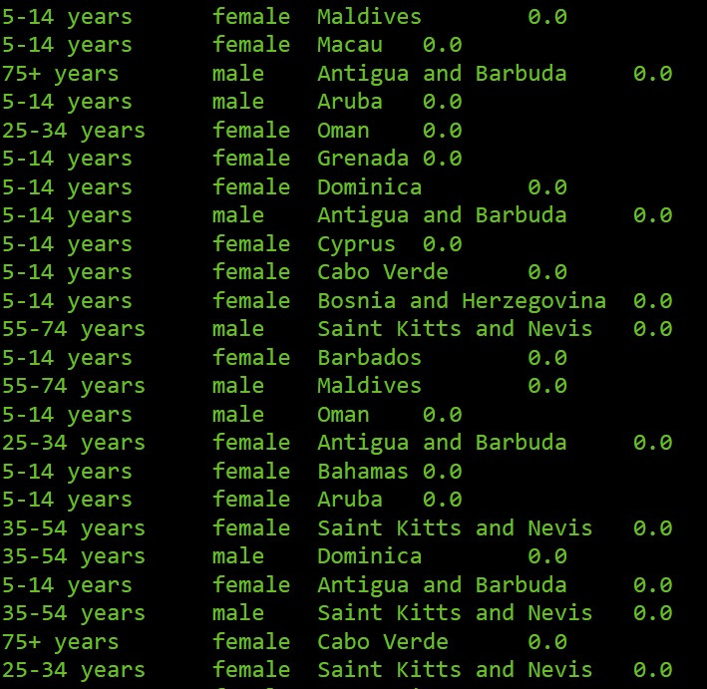
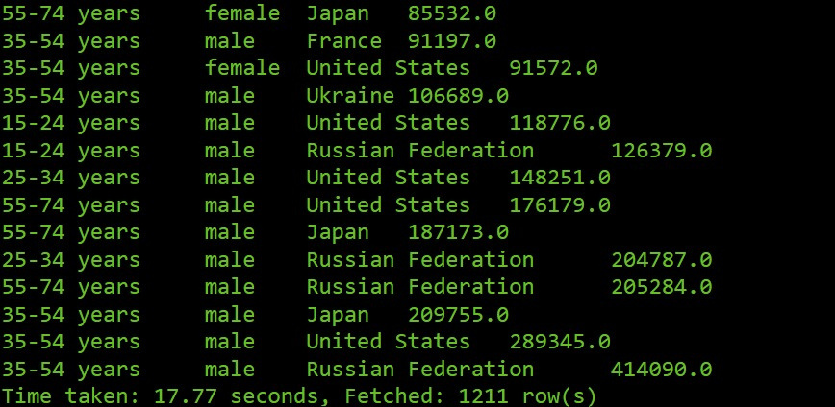
Age, Gender, Country And Total Suicide

Slide 13

Generation Vs Avg Suicide Rate

Slide 14
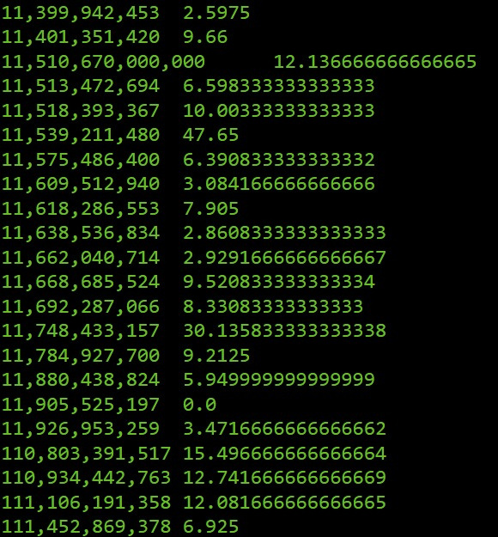
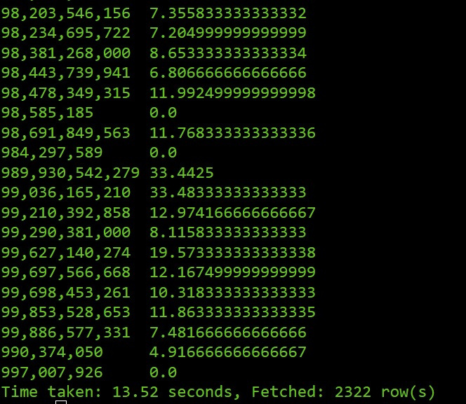
GDP Vs Avg Suicide Rate

Slide 15
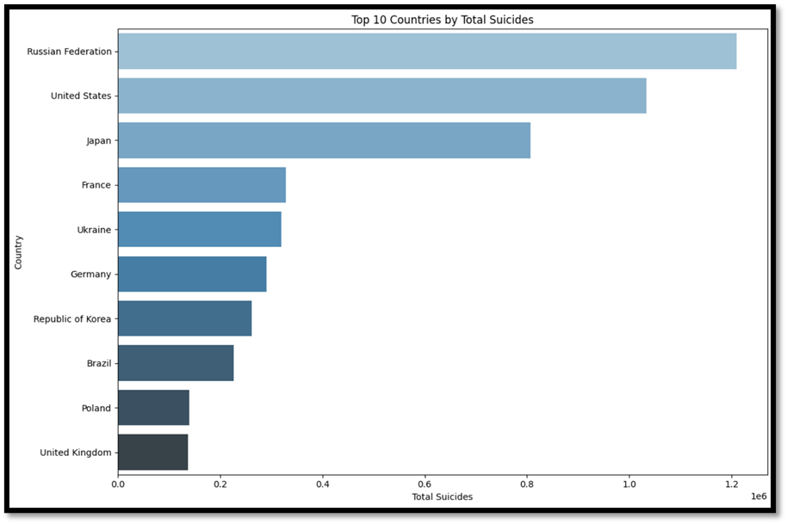
Top 10 Countries by Suicides
Russian Federation: This country has the highest number of total suicides among the top 10 listed.
United States and Japan: These two countries have the next highest numbers of total suicides.
France, Ukraine, Germany, Republic of Korea, Brazil, Poland, and United Kingdom: These countries have progressively lower numbers of total suicides, with the United Kingdom having the lowest among the top 10 listed.

Slide 16
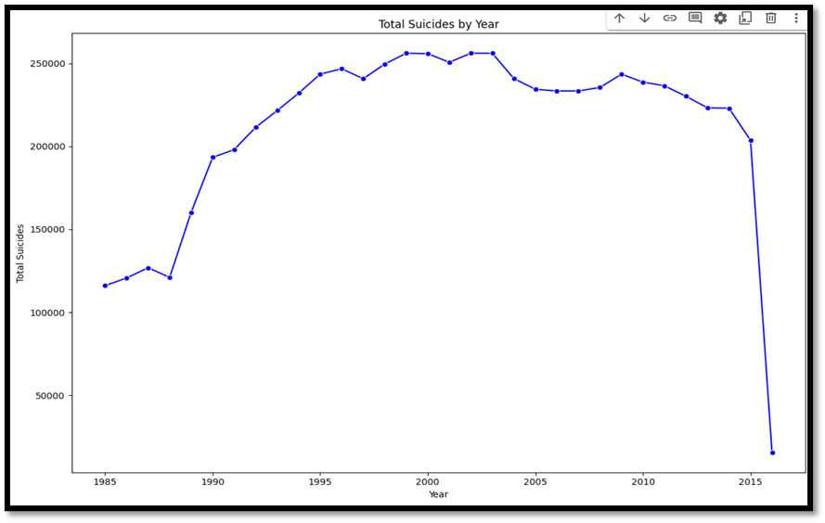
Total Suicides Per Year
Overall Trend: There is a general increase in the number of suicides from 1985 to around 2000, followed by a period of relative stability, and then a significant decrease in the later years.
Fluctuations: The graph shows some fluctuations within this overall trend, with years of higher and lower suicide rates.
Peak Years: The peak years with the highest number of suicides appear to be around 2000.
Sharp Decline: A sharp decline in suicides is observed after 2010

Slide 17
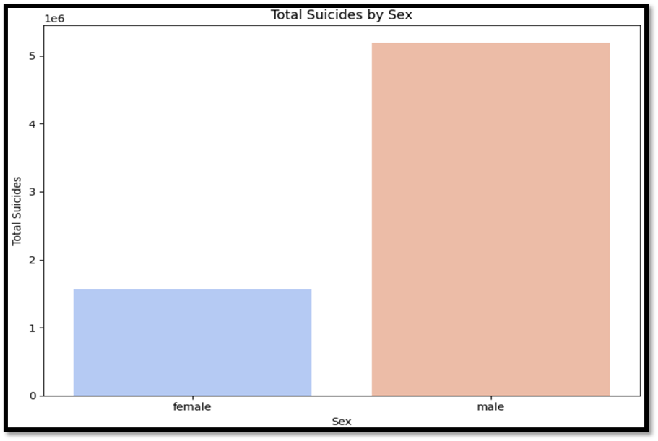
Suicides by Gender
The chart clearly shows that the number of male suicides is significantly higher than the number of female suicides

Slide 18
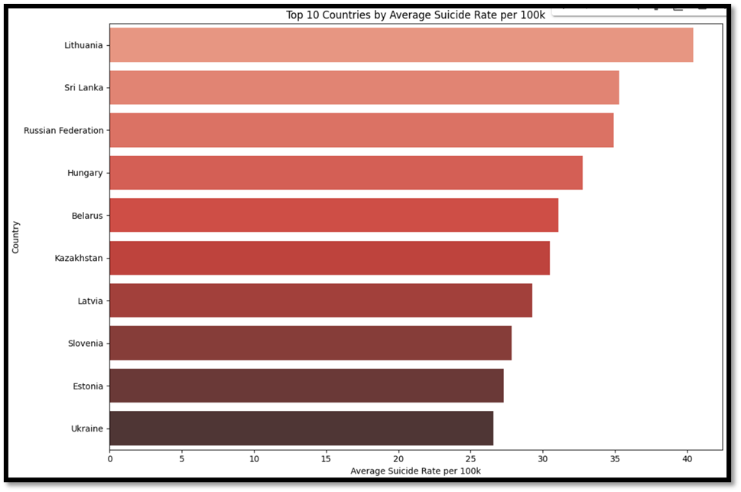
Top 10 Countries by Avg Suicide Rate per 100k people
Lithuania has the highest average suicide rate per 100,000 people among the top 10 listed.
Sri Lanka, Russian Federation, Hungary, Belarus, Kazakhstan, Latvia, Slovenia, Estonia, and Ukraine are countries have progressively lower average suicide rates per 100,000 people, with Ukraine having the lowest among the top 10 listed.

Slide 19
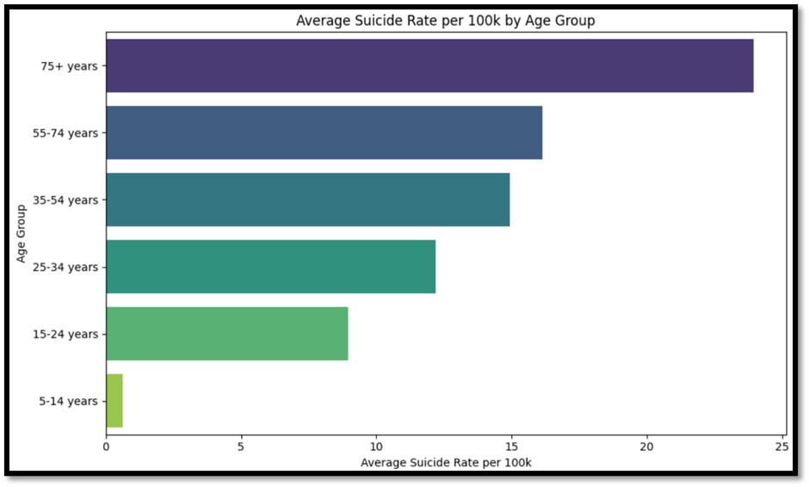
Suicides by Age Group
The chart shows the average suicide rate per 100k people for different age groups, with the highest rate observed among the 75+ age group and the lowest rate among the 5-14 age group.

Slide 20
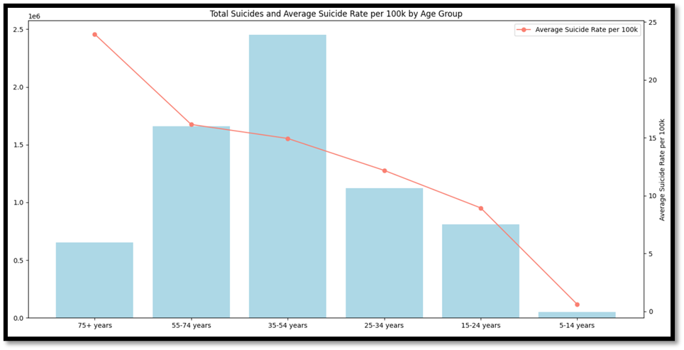
Total Suicides and Avg Suicide Rate by Age Group
The chart shows the total number of suicides and the average suicide rate per 100k people for different age groups. The 75+ age group has the highest total number of suicides, while the 5-14 age group has the lowest.
The average suicide rate per 100k people decreases with age, with the highest rate among the 75+ age group and the lowest among the 5-14 age group.

Slide 21
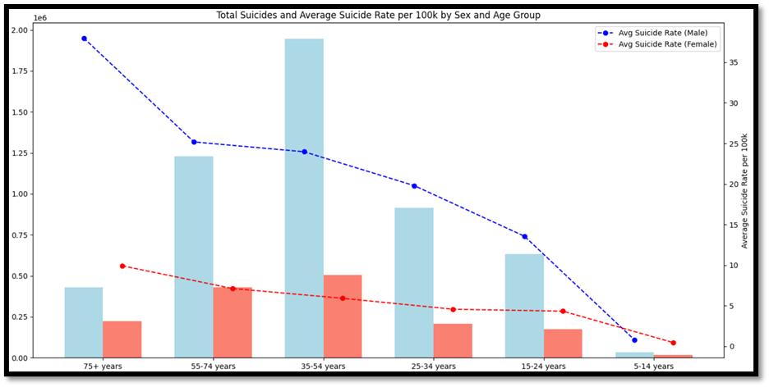
Total Suicides and Avg Suicide Rate by Age Group and Gender
The chart shows the total number of suicides and the average suicide rate per 100k people for different age groups, broken down by sex.
The 75+ age group has the highest total number of suicides, while the 5-14 age group has the lowest.
The average suicide rate per 100k people is higher for males than females across all age groups, with the highest rate observed among older males

Slide 22
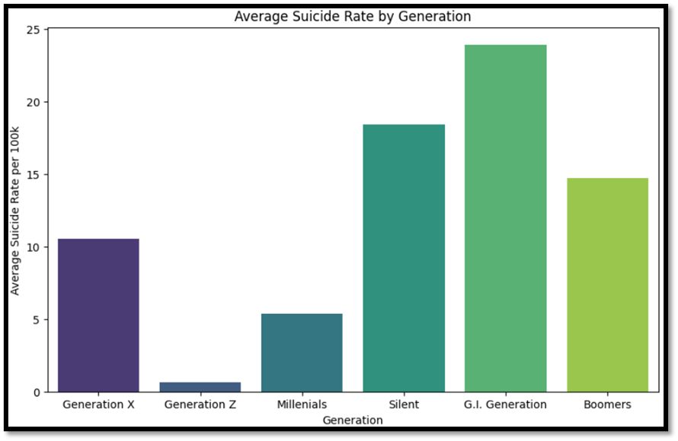
Avg Suicide Rate by Generation
The chart shows the average suicide rate per 100k people for different generations, with the highest rate observed among the G.I. Generation and the lowest rate among Generation Z.

Slide 23
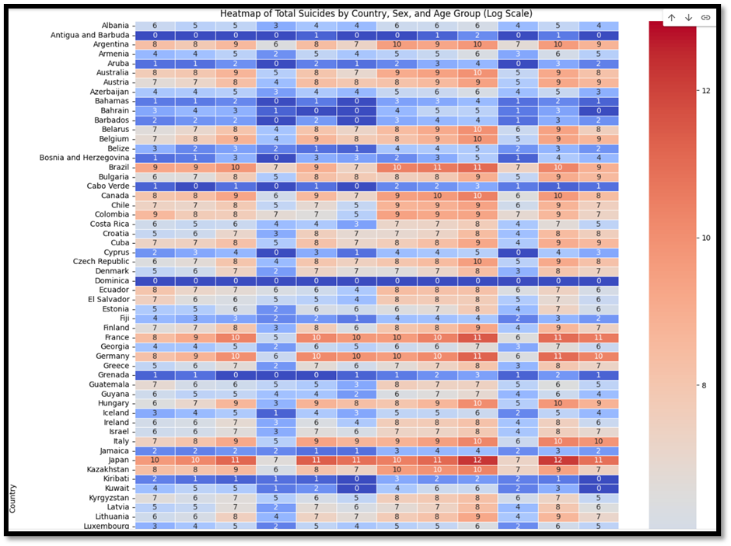
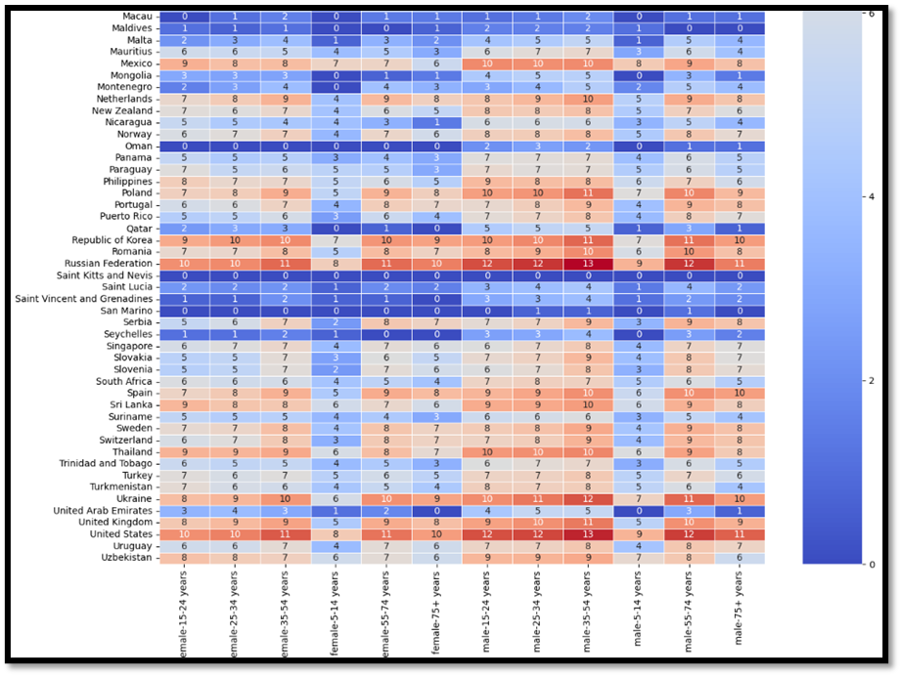
Heatmap of Total Suicides by Country, Gender,Age Group

Slide 24
Heatmap of Total Suicides by Country, Gender,Age Group
The heatmap provides a visual representation of the changes in suicide rates per 100k people for various countries and age groups between two specific time periods. Each cell in the heatmap corresponds to a particular country-age group combination, and the color intensity indicates the magnitude of change in the suicide rate.
Red shades represent an increase in the suicide rate, while blue shades indicate a decrease.
In San Marino and Saint Kitts and Oman and (Barbuda & Antigua) has least suicide rates in female at all ages.
Dominica has zero suicide rates in both male and female at all ages.
Russian Federation and United states and Korea and Japan have more suicide rates, but male suicide rate has slightly more than female.

Slide 25
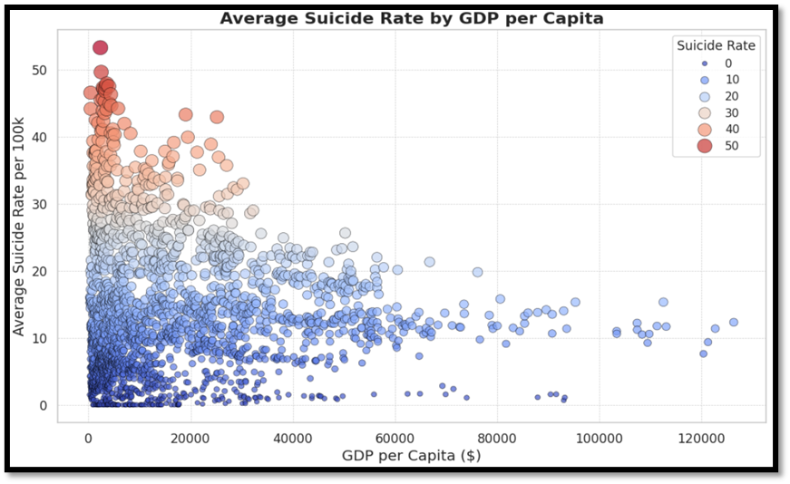
Avg Suicide Rate by GDP
The scatter plot shows the relationship between the average suicide rate per 100k people and the GDP per capita for different countries. The size and color of the points represent the suicide rate, with larger and darker points indicating higher suicide rates.
There seems to be a negative correlation between the two variables, suggesting that countries with higher GDP per capita tend to have lower suicide rates. However, there is also a significant amount of variation within each GDP level, indicating that other factors besides GDP play a role in suicide rates.

Slide 26
Conclusion
The analysis of global suicide data uncovers trends in years, gender, regions, and age groups, reflecting the complexity of suicide risk factors. Suicides generally rose from 1985, peaked in the mid-1990s, and then saw a decline, with 1999 recording the highest number of cases (256,119) and 2016 the lowest (15,603). This trend may be influenced by evolving social conditions, mental health awareness, and prevention initiatives.
Gender disparities are prominent: men have a suicide rate of around 20 per 100,000, while for women, it’s about 5 per 100,000. With males accounting for over 10 million suicides compared to 3 million for females, the data suggests men might benefit from targeted interventions.
Country-specific data shows higher suicide counts in nations like Russia, the United States, and Japan, with regions such as Lithuania and Sri Lanka reporting some of the highest average suicide rates. Meanwhile, Dominica and Saint Kitts & Nevis have low rates, potentially due to unique cultural or economic factors.
Age also plays a role, with the 75+ age group having the highest rate (24 per 100,000), though those aged 35-54 record the largest total number of suicides. This highlights the need for tailored support for middle-aged and older adults to address their specific vulnerabilities.

Slide 27
Thank You!

